Slide 1
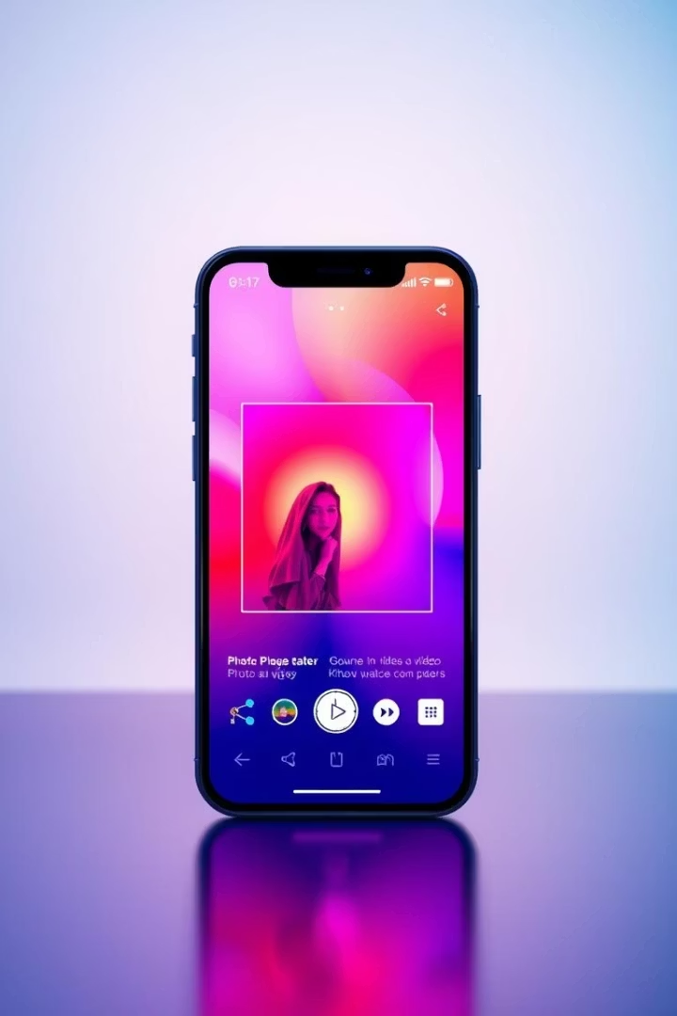
True ZONE
True Zone is a versatile photo and video sharing app designed to provide an engaging and immersive social experience. Available on both iPhone and Android, it offers seamless multimedia sharing with a user-friendly interface. Whether you're capturing moments or exploring content, True Zone combines speed, security, and simplicity in one powerful platform.

Slide 2



Meet Our Development Team
Our dedicated team of experts drives the innovation behind True Zone. Backend engineers focus on robust server-side development ensuring smooth performance and scalability. Frontend engineers craft an intuitive and responsive user interface. UI/UX designers create engaging user experiences that keep users connected. Our proactive support team ensures that users receive timely assistance and continuous improvements.
Backend Engineers
Frontend Engineers
UI/UX Designers
Support Team
Prashant Mishra, Gokul Pawar
Tmana Abbasi, Nitisha Kumar
Ayush Raj, Vishal Kumar
Dilnawaz Hussain, Atul Kumar, Prince Kumar, Akash Kumar

Slide 3





Application Workflow Overview
True Zone’s seamless user journey ensures a smooth and secure experience. Starting with quick registration, users create accounts easily. Login and authentication secure access, protecting user data. Once logged in, users navigate the home screen to create and share posts efficiently. Interaction is encouraged through likes, follows, and messaging. Personal profile management ensures that users hold control over their information and content.
Registration
User creates an account
Login & Authentication
Secure user access
Home & Post Creation
View and create posts
Engagement
Like, follow, and message users
Profile Management
Maintain personal information

Slide 4
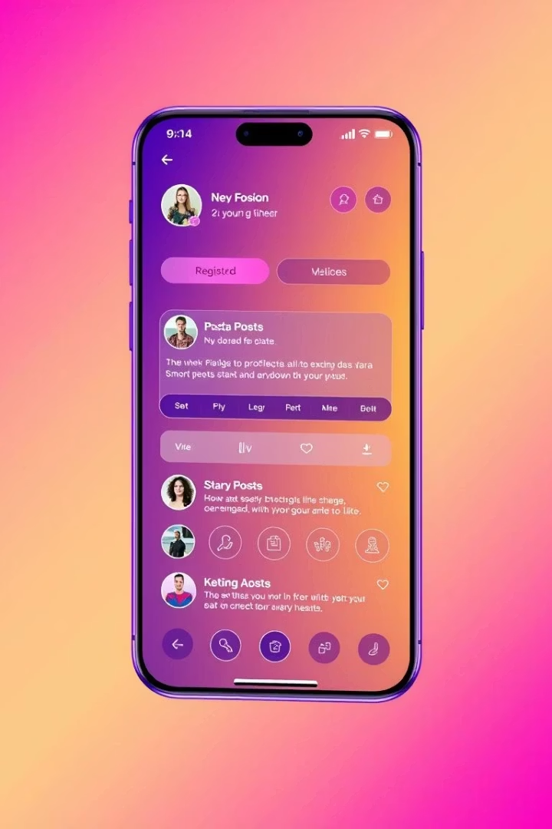
Key Features of True Zone
True Zone combines essential features to provide an engaging and secure user experience. Our user registration and login systems ensure quick and safe access. Post management allows users to easily create, upload, and archive multimedia content. The engagement system promotes social interaction via likes and follows. Seamless Restful API integration connects frontend and backend efficiently, ensuring real-time responsiveness and stability.
User Registration & Login
Secure account creation and authentication for smooth access.
Post Management
Create and upload multimedia content with effortless archiving.
Engagement System
Interact with likes, follows, and community-building features.
Restful API Integration
Ensures seamless real-time backend communication and performance.

Slide 5

Project Timeframe & Cost
Our development team's focus is on delivering the True Zone app within a strict 7-day timeline. This rapid development ensures market entry with competitive speed while maintaining quality and reliability. The agile scheduling includes thorough testing to meet deadlines without sacrificing performance or security.
The fixed timeframe reflects our confidence in the team's efficiency and expertise, aiming for a seamless launch that meets user expectations and investor requirements.
Expected Completion
All core features delivered within seven days.
Maximum Time Allowed
Strict adherence to a seven-day project deadline.

Slide 6
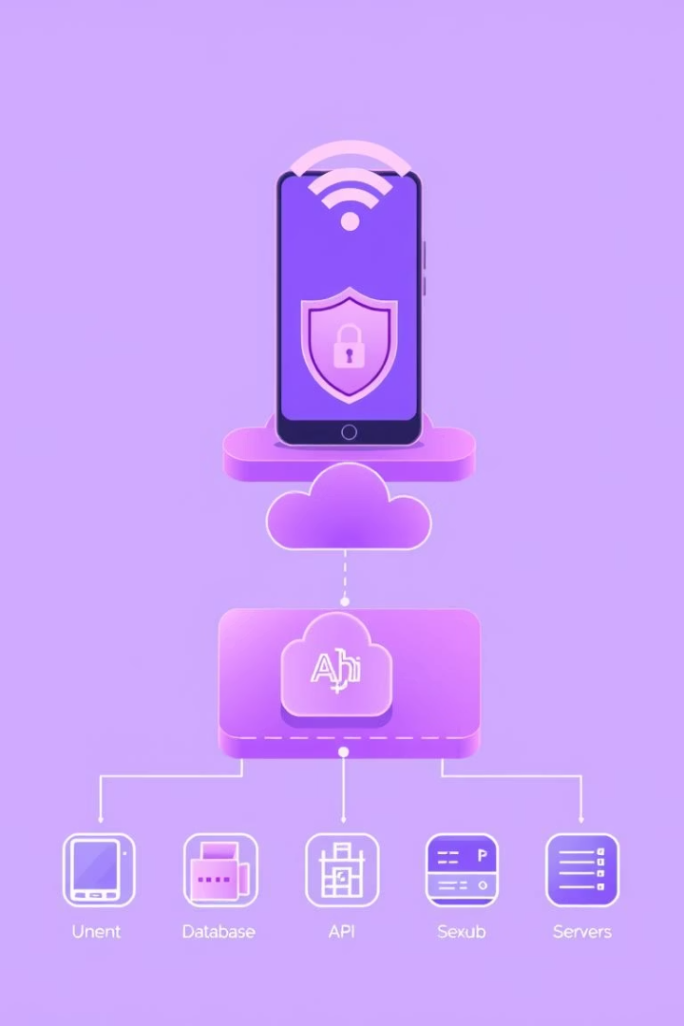
Technical Requirements and Dependencies
True Zone is built on a modern technology stack that ensures scalability, security, and performance. Authentication utilizes mobile number OTPs and traditional email/password combinations, secured via JSON Web Tokens and bcrypt hashing. The frontend employs React.js with React Router Dom for seamless navigation, while the backend is powered by Node.js and Express.js. MongoDB with Mongoose handles data storage, and Cloudinary provides efficient cloud media hosting.
Authentication
Mobile OTP, email/password, JWT, and bcrypt for high security.
Core Tech Stack
React.js and React Router Dom
Node.js and Express.js
MongoDB with Mongoose
Cloudinary for media storage

Slide 7
How Our App Is Different
True Zone prioritizes safety and authenticity. Our secure login includes age verification to prevent underage users from accessing sensitive content, an essential step for community trust. A built-in moderation system detects and blocks inappropriate uploads, maintaining clean content. Anti-fake account mechanisms use device identification to minimize spammers, creating a genuine user ecosystem. Our app fosters a friendly environment suitable for all ages with future parental control options planned to enhance safety.
Secure Login with Age Verification
Content Moderation
Protects minors from accessing sensitive content.
Automated detection of inappropriate uploads.
Anti-Fake Account System
Clean, Friendly Environment
Device identification prevents spamming and fake profiles.
Suitable for all age groups with parental control in the pipeline.

Slide 8

THANK YOU
We appreciate your interest in True Zone. This app represents the future of secure and enjoyable photo and video sharing, designed with users and investors in mind. Your support powers our journey to launch a platform that blends entertainment, safety, and innovation seamlessly. Let’s create vibrant social connections together!

